Slide 1

MADE BY - DEEPA KUMARI

Slide 2
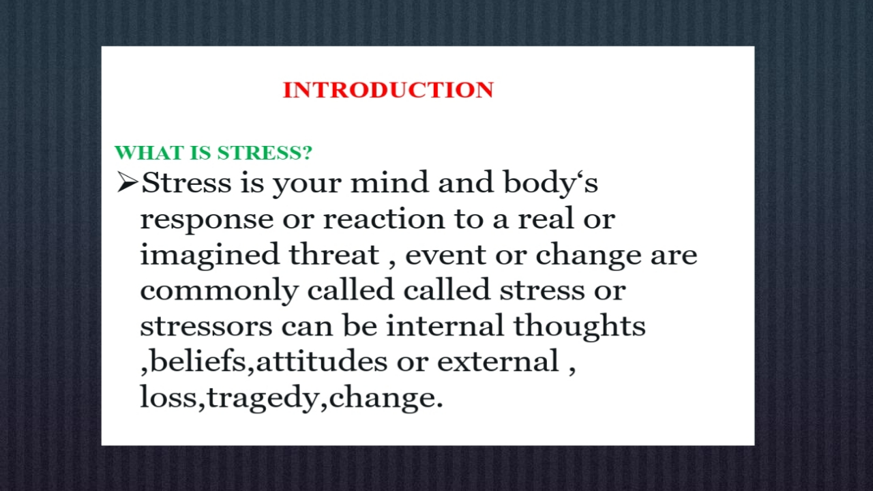

Slide 3
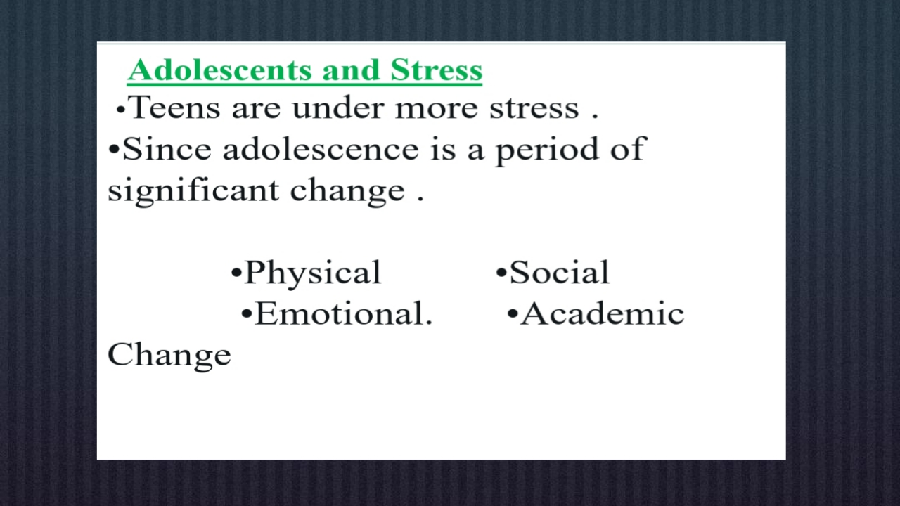

Slide 4
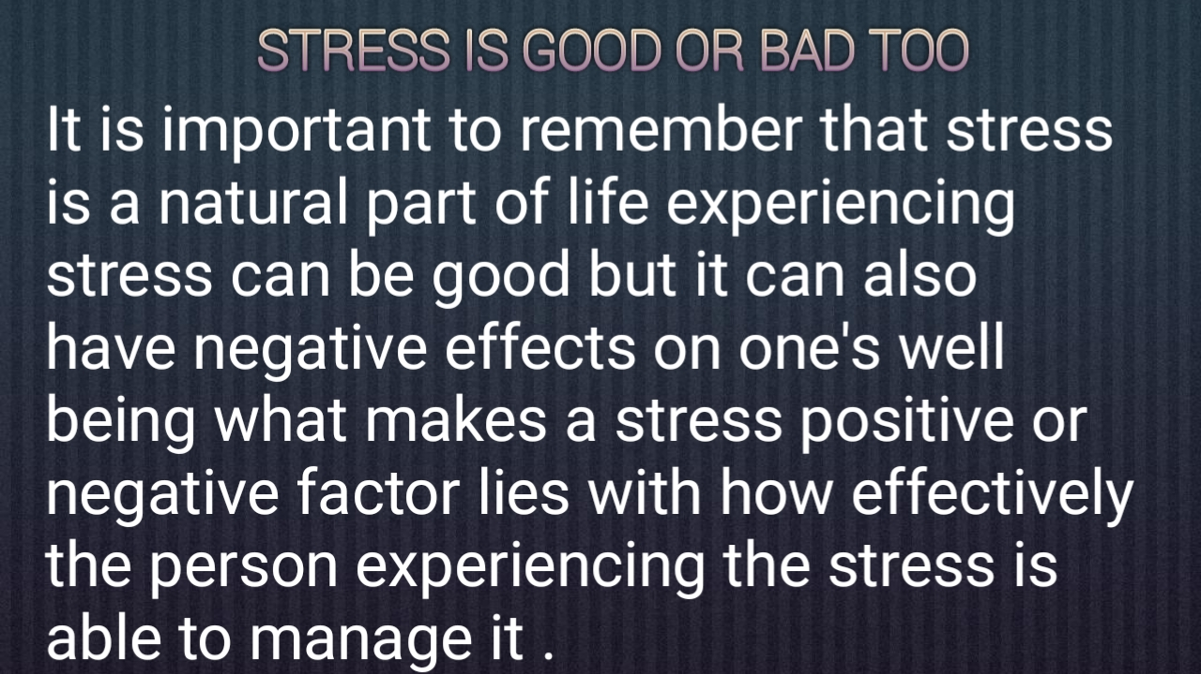

Slide 5
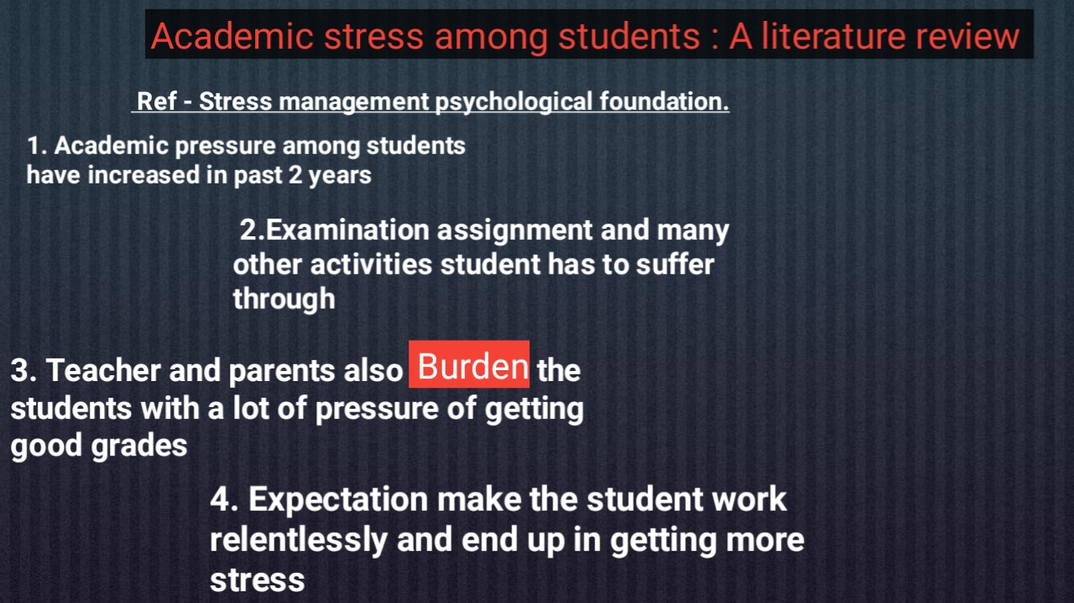

Slide 6
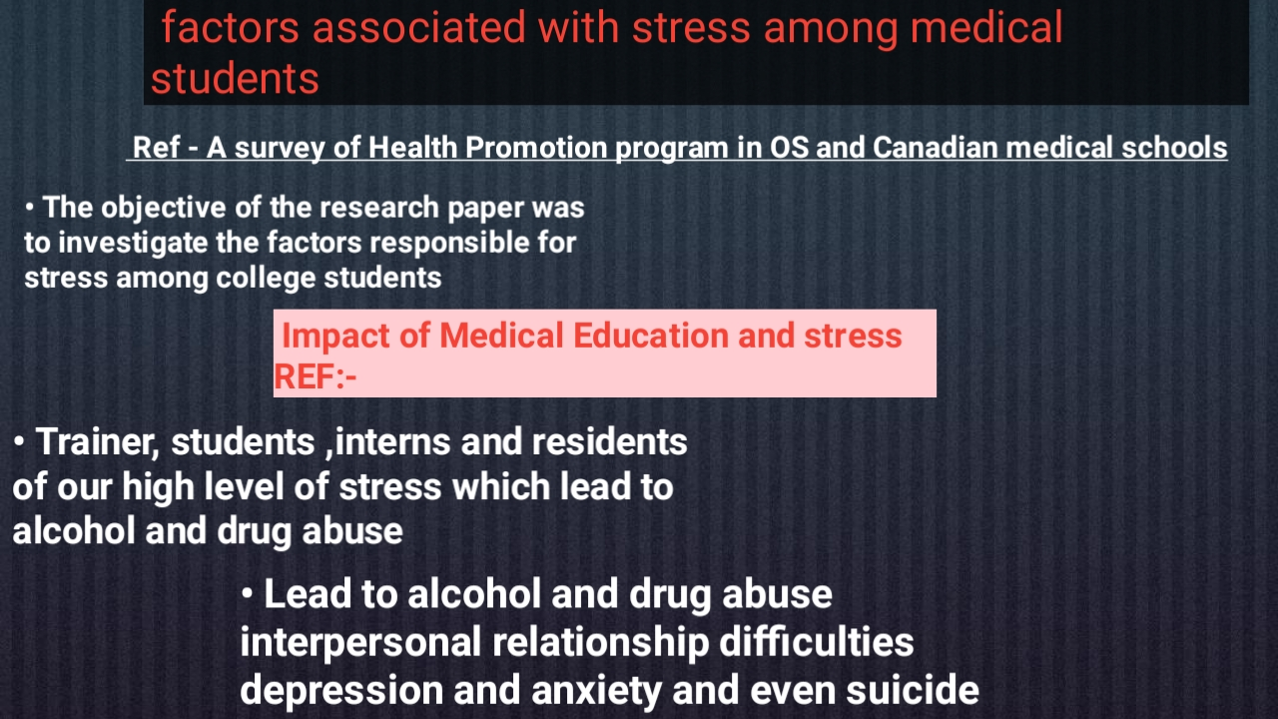

Slide 7
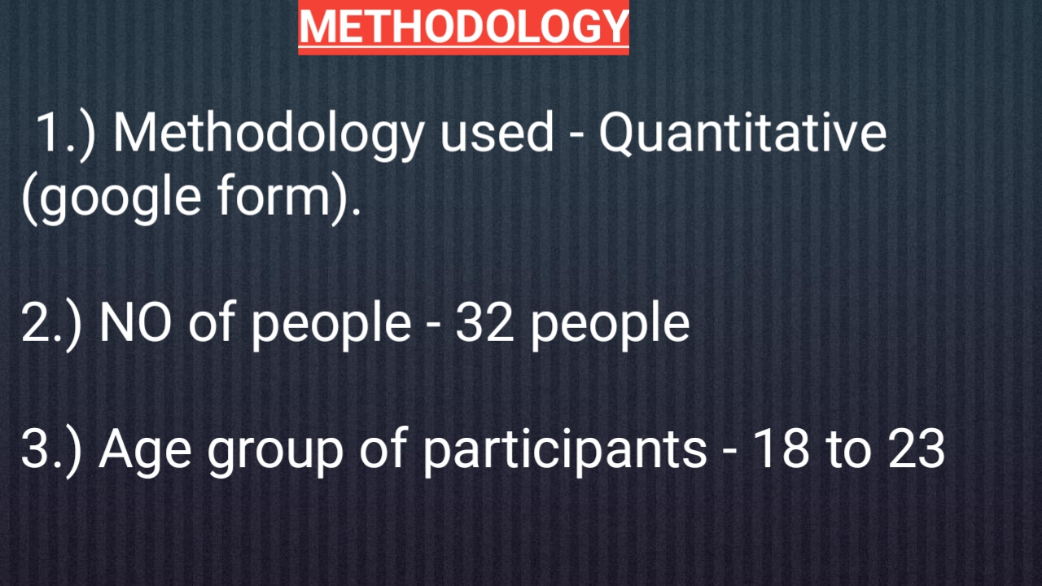

Slide 8
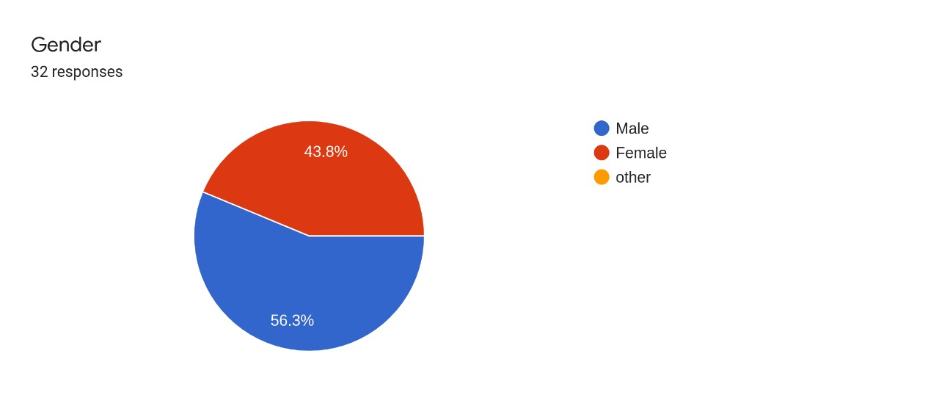
RESULT AND OBSERVATION

Slide 9
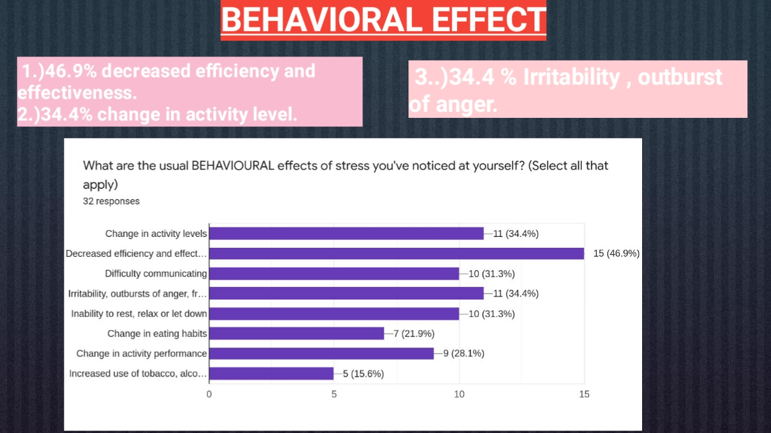

Slide 10
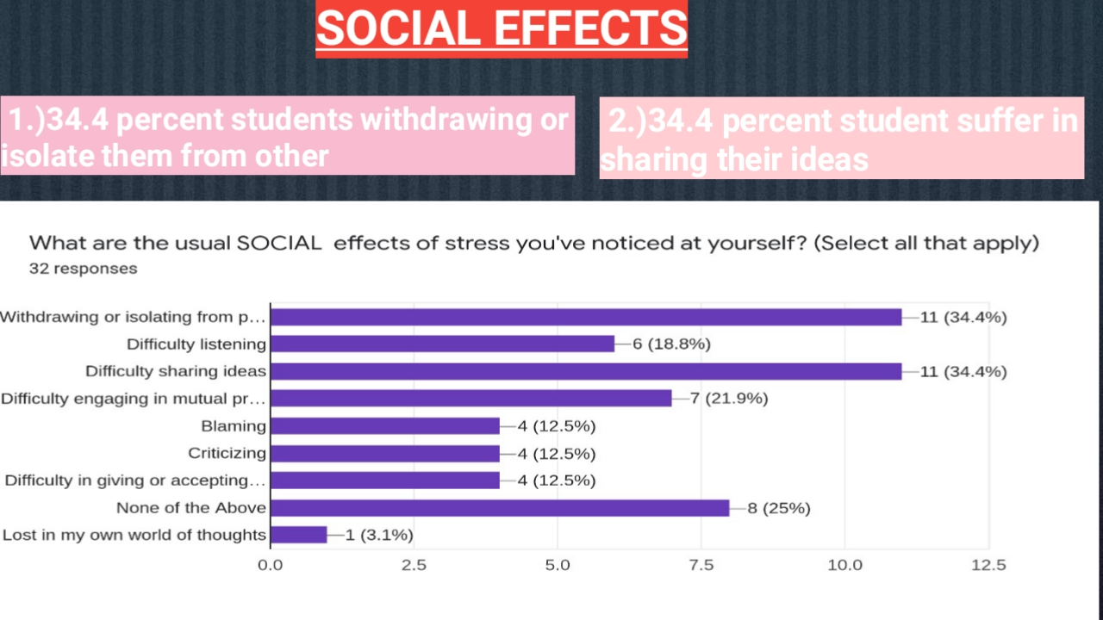

Slide 11
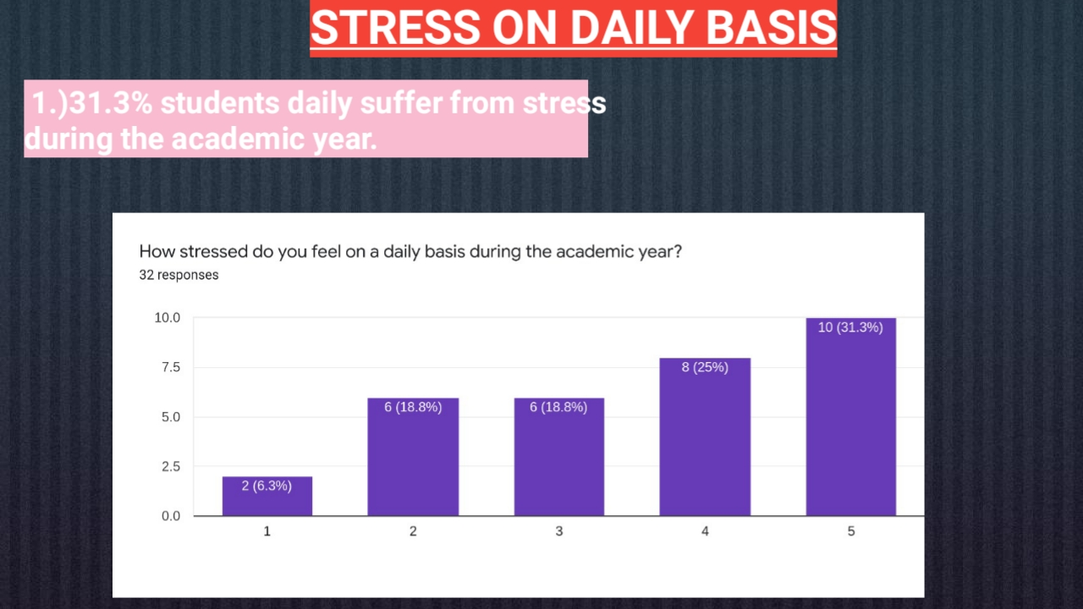

Slide 12
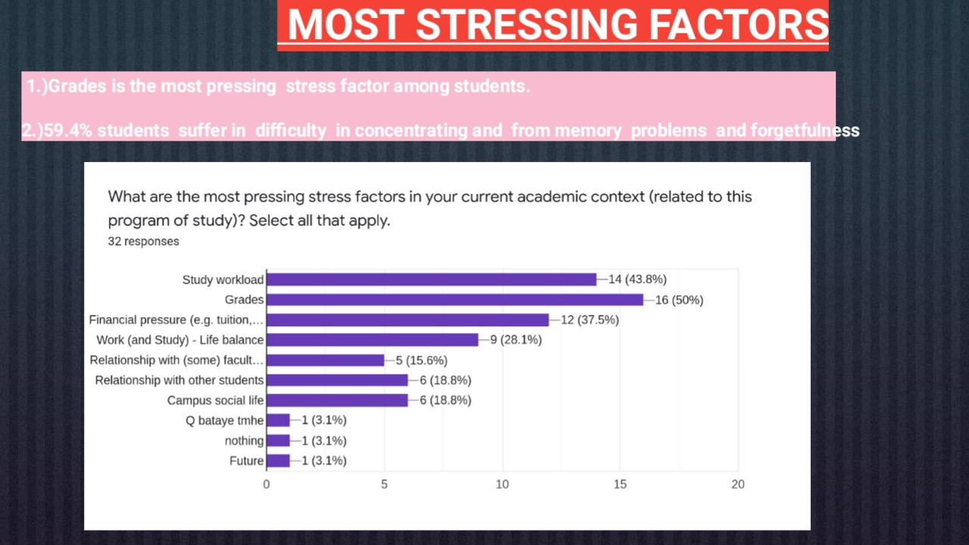

Slide 13
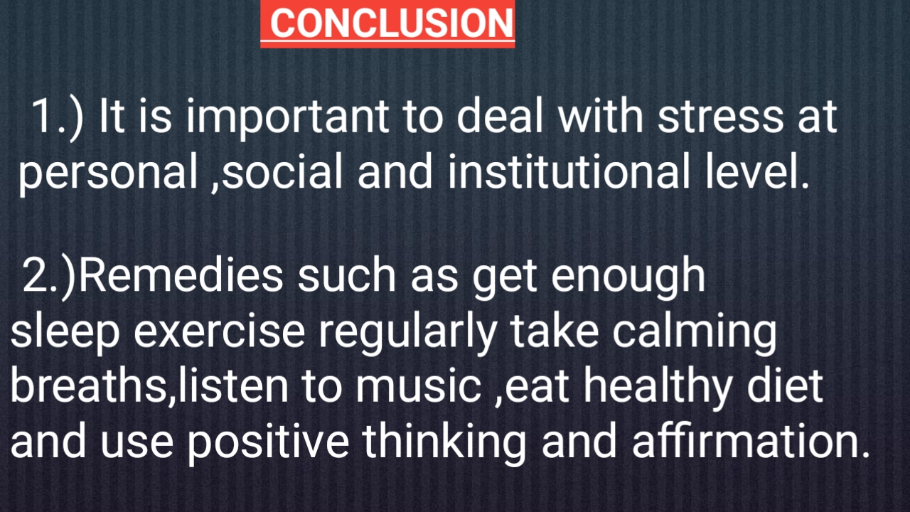

Slide 14

www.google scholar.com
questionpro.comhttps://www.questionpro.com › stu...18 Student Stress Survey Questions for Questionnaire + Template - QuestionPro
timely.mdhttps://timely.md › blog › stress-m...12 Tips to Manage Stress for College Students - TimelyMD

Slide 15


